Slide 1
FIND YOUR PASSION
Welcome to our project. As the topic suggests our project is based on finding passion of an individual. In this the user must have to answer some basic questions and at last our program will show his/her passion. There are total 10 number of questions and all the questions are MCQs. You just have to write 1, 2, 3 or 4 as the answer.

Slide 2
Objective
This project is an activity or enterprise that you decide to take on—usually in your spare time–in order to gain some benefit for yourself. That is, it’s a challenge that you willingly embrace because you hope to gain something from it.
You may be currently going through a period of your life in which you feel you have little control over your daily activities. You can regain a feeling of control by this find your passion project.
The list of benefits that you can gain from this project is long

Slide 3
Implementation
As discussed in introduction this program will help you to find your passion.
When you will start this software, it will first ask you to enter your name.
After you enter your name it will start asking you MCQ’s based questions which you have to answer.
There are total 10 questions.
After you answer the 10th question, it will show you your passion.

Slide 4
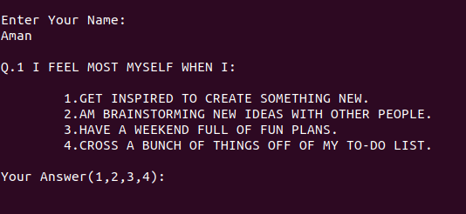
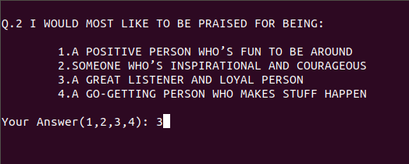

Slide 5


Slide 6
Conclusion
Hence this project concludes that you can find your passion from this software.
This software can be useful to many areas.
It provides easiness to the user.
Finally the project is implemented and tested according to test cases.

